Slide 1
Data mining FINAL project soccer – Success prediction
Prepared By:
Sathish Prabakaran

Slide 2
Index
Introduction on Football
The Data
Overview on Objectives
Road blocks to roadmap
Created Views
Observations and Data reduction
Objective 1 -> Predictive Modeling -> Model Comparison
Objective 2 -> Data Gathering -> Dimensional Reduction -> Data Extraction -> Probability Calculation
Review the Results
Business Opportunities

Slide 3
FOOTBALL
Nicknamed “The Beautiful Game”
World’s most popular sport
Played by 250 million people in over 200 countries
Involves huge monetary transactions in buying a player, funding by sponsors, ticket purchase by fans, maintaining a franchisee for a team in league, etc.
As well as huge money is spent by people in authorized betting firms.

Slide 4
The data
European Soccer Database
25k+ matches, players & teams attributes for European Professional Football
Inside the Database:
Match (including Betting odds)
League
Country
Player
Team
Attributes of Players and Teams

Slide 5
Objectives
Objectives considered for the Project
Objective 1: Find dominant styles of teams to associate them with win ratio to decisively assist team management to choose strategy prior to a league.
Objective 2: Find the probability of winning based on the home team and away team’s playing styles and player ratings

Slide 6
Road blocks to roadmap
Few of the road blocks that impacts the progress of the project
Dataset not being clean to build a model right away
Multiple tables
Domain expertise to make predictive plans
Missing values

Slide 7
Data set to create a model
Multiple Views on ‘Match’ ‘Team’ and ‘Team Attributes’ to understand how attributes influence win
Matching and combining data columns across tables.

Slide 8
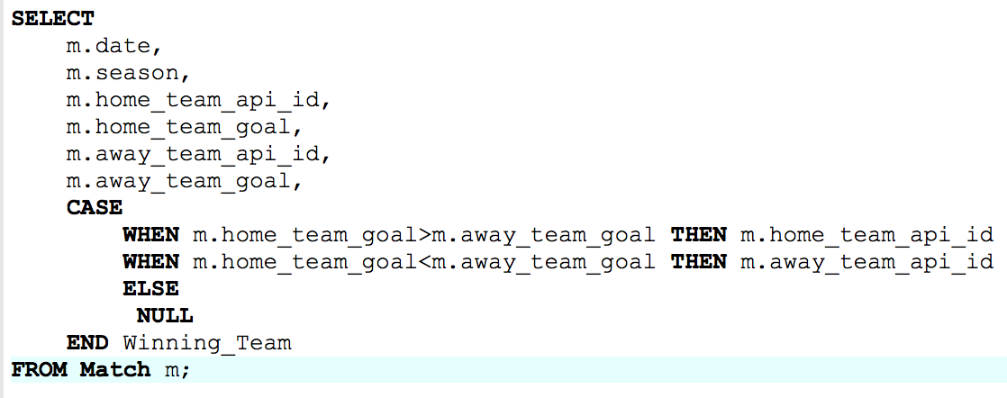
Views
Match Win Status

Slide 9
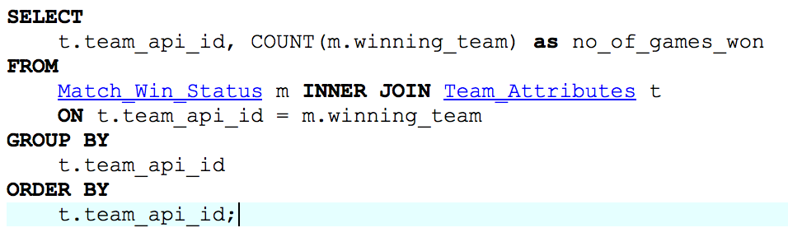
VIEWS
Team Winning Game Count

Slide 10
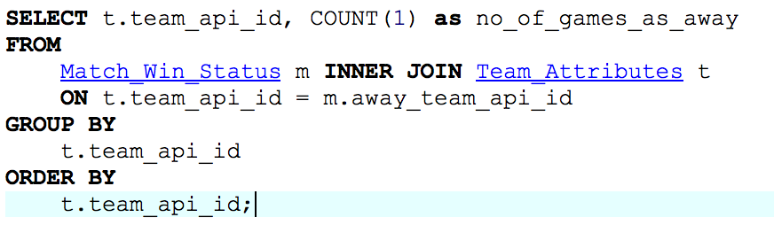
VIEWS
Away Game Count for Each Team
Total game count was derived from this.

Slide 11
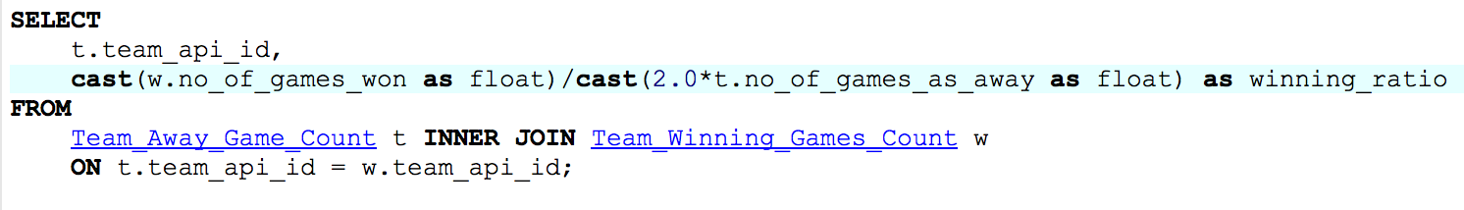
VIEWS
Winning Ratio Plotted for Each Team

Slide 12
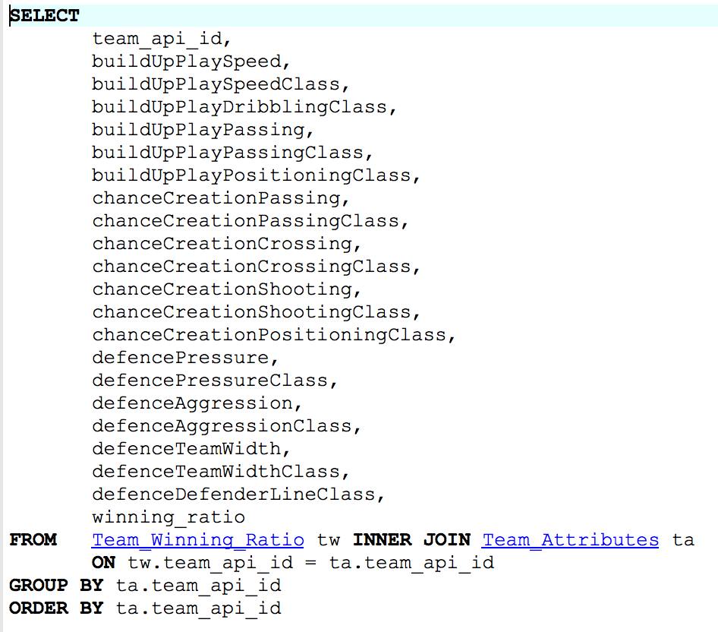
VIEWS
The Data Set we Built Models On

Slide 13
Observations
Please find the observations that are made:
There are no null values to be imputed.
Home Game Count = Away Game Count since the match details are for leagues.

Slide 14
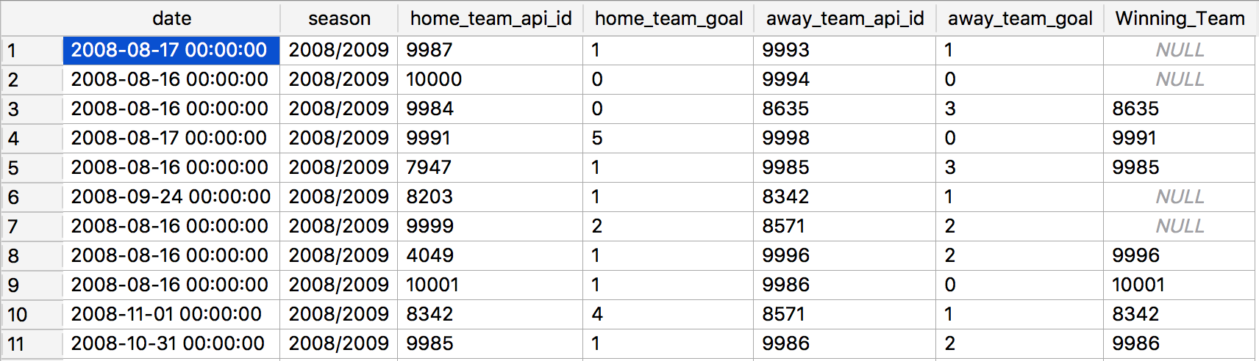
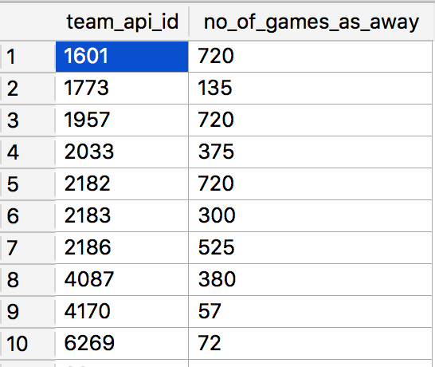
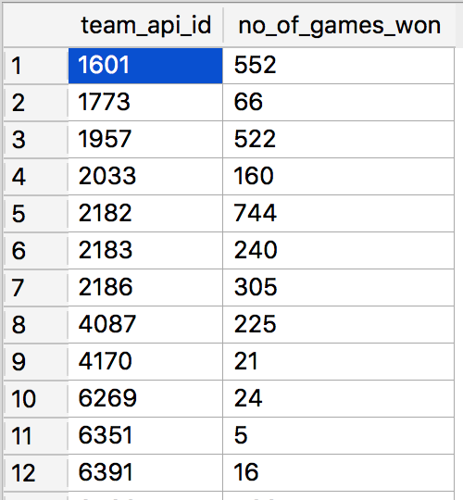
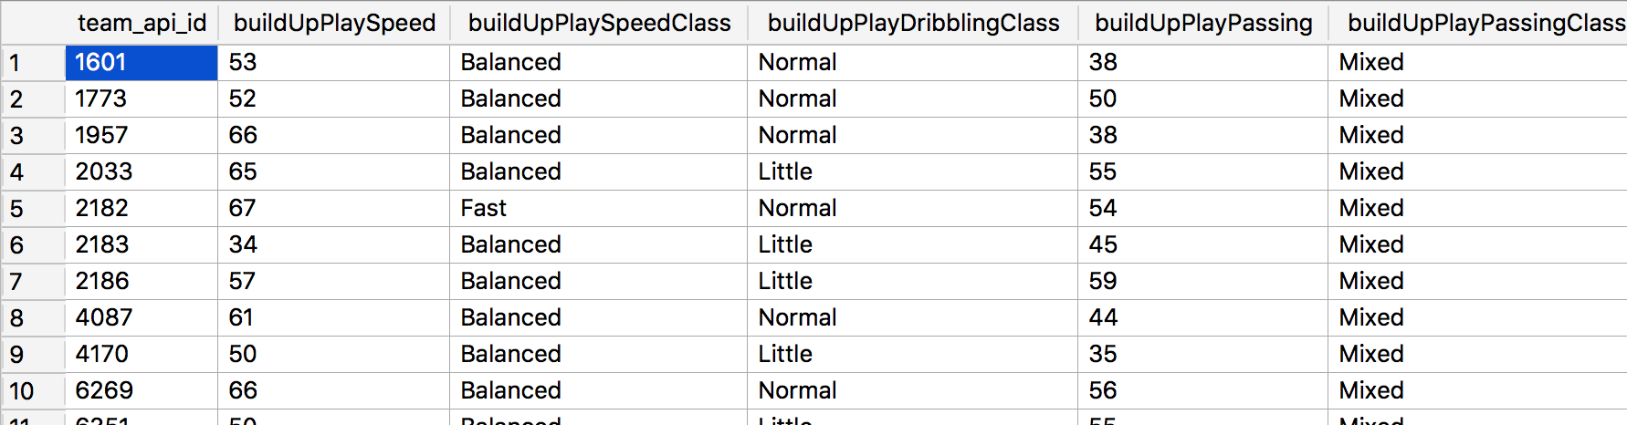
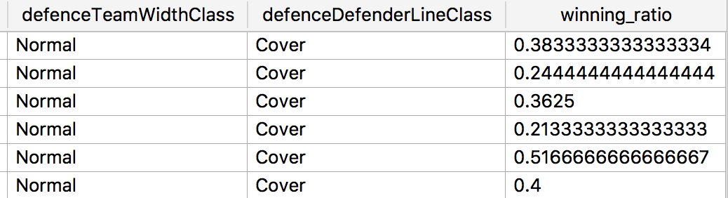
Data reduction

Slide 15
Objective 1
The scenarios considered for Objective 1 are:
Assist Management to Choose Formation and Play Style.
Help Pick players to achieve a particular play style.
Match Anticipated opponent Style.

Slide 16
Predictive Modeling
Neural Network
Best for predicting non-linear relationship
Complicated to understand
Linear Regression
Works best with linear relationships

Slide 17
DEMO

Slide 18
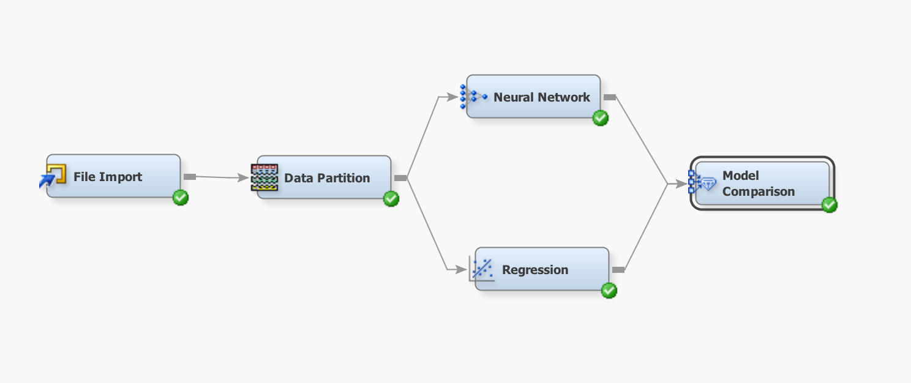
Model Comparison
After Building Models on SAS Enterprise Miner
Model | Validation MSE | Training MSE
Linear Regression | 0.013319 | 0.012732
Neural Neural Network | 0.027303 | 0.002397

Slide 19
OBJECTIVE 2
The scenarios considered for Objective 2 are:
Predicting the probability of win by home team
Considering attributes of home team and away team

Slide 20
DATA GATHERING
3 tables are combined to form the input data for the predictive model
Matches table, contains the data of which team is playing against which team in each match and the list of players in each team, betting odds for home side win
Player_Attributes table contains data on player’s overall rating
Team_Attributes table contains data on team attributes

Slide 21
DIMENTIONAL REDUCTION
VLOOKUP function is use to match results between matches table and player attribute table, matches table and team attribute table
Not all fields in the data are considered to reduce data dimension
Player rating of each player is averaged in the new table

Slide 22
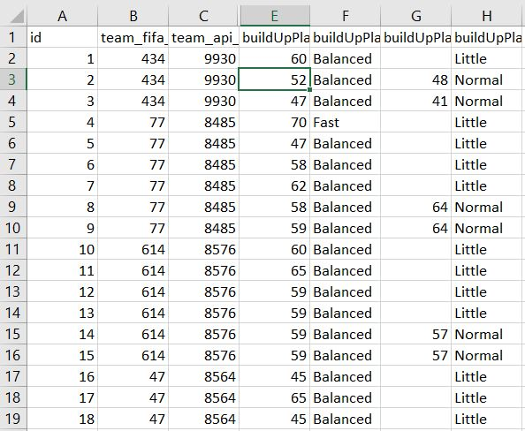
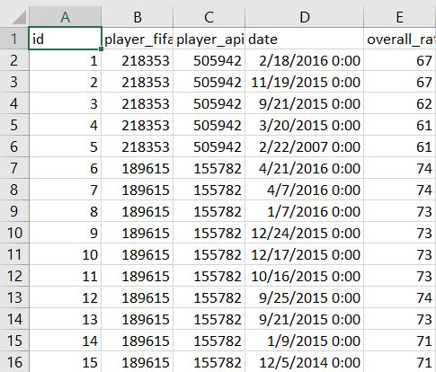
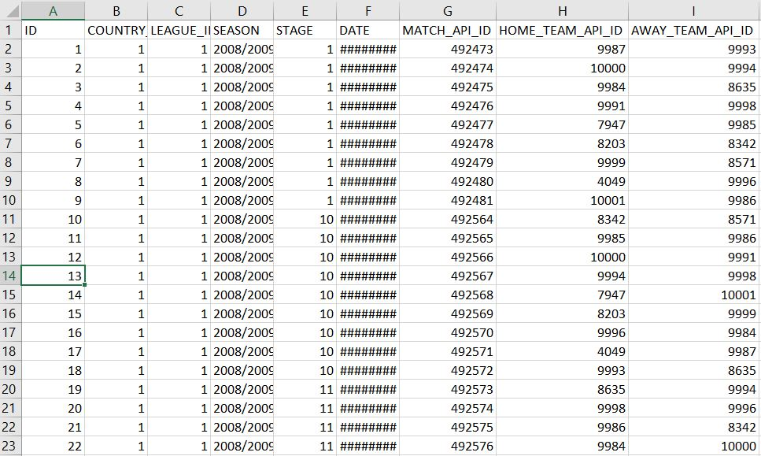
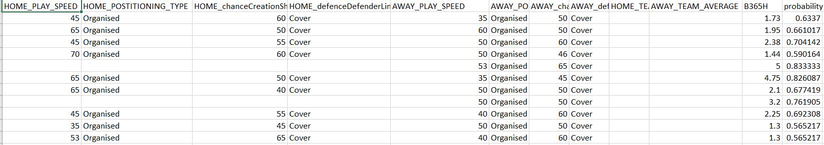
DATA EXTRACTION
Match Table
Team Attribute Table
Player Attribute Table

Slide 23
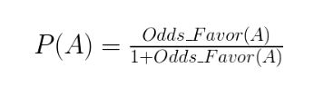
PROBABILITY CALCULATION
The probability of the home team win can be derived from the odds of the home team win
The mathematical relation
REFERENCE : http://stats.seandolinar.com/statistics-probability-vs-odds/
ODDS(B365H) | Probability
1.73 | 0.6337
1.95 | 0.661017
2.38 | 0.704142
1.44 | 0.590164
5 | 0.833333

Slide 24
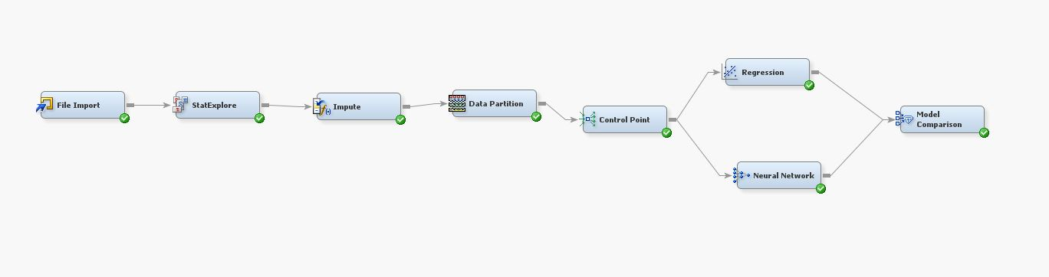
PREDICTIVE MODELLING
As the target variable is continuous, we would be using Linear Regression and Neural Network for building a predictive model

Slide 25
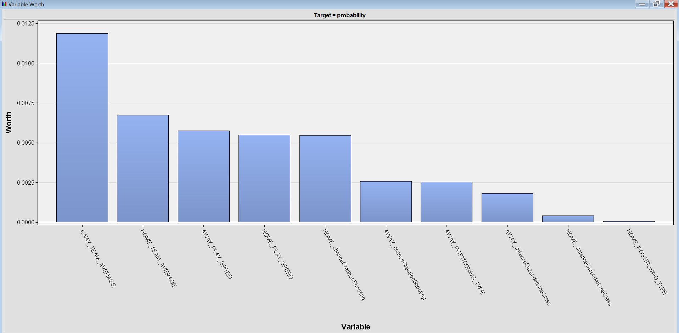
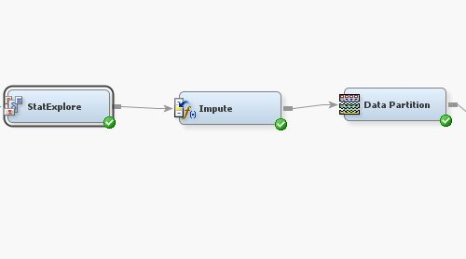
Observation
Variable importance can be determined using StatExplore
Missing values are imputed using Impute Function

Slide 26
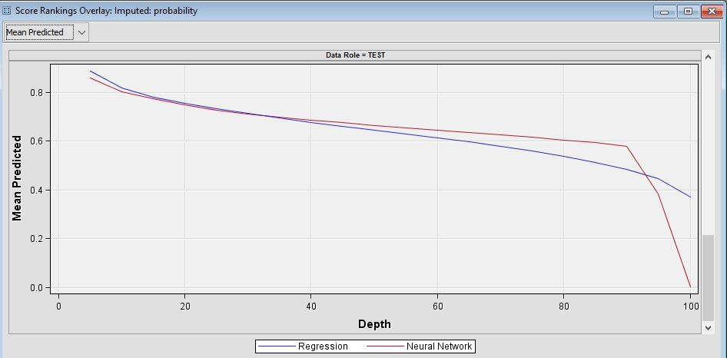
RESULTS
Regression Model
Statistics Label | Train | Test
Average Squared Error | 0.024465 | 0.022792
Neural Network
Statistics Label | Train | Test
Average Squared Error | 0.006869 | 0.00632

Slide 27
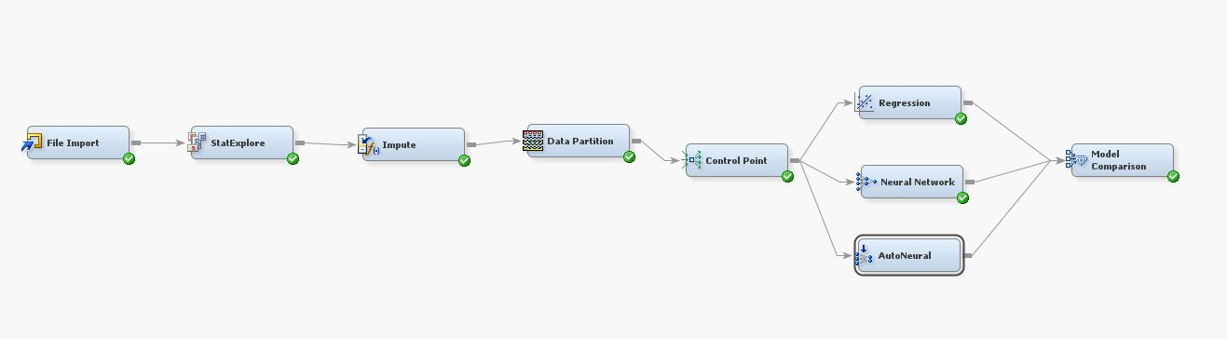
Additional MODELS
We implemented AutoNeural as well in the model. As no significant improvements were observed, we reverted back to the old model.
Decision Tree cannot be used as the target variable is continuous

Slide 28
business opportunities
Our model could be used by a football Manager to come up with Team Strategy to be followed against a particular opponent.
Also, Our model could also be leveraged for selecting which set of player could be ideally taken for a game.
Our model could be used by upcoming newly established betting sites for calculating probability of winning a game by a team.
This can be used to come up with odds for the game.
Effective Predictions can be made when driven by data rather than speculation.

Slide 29
THANK YOU!

